Slide 1
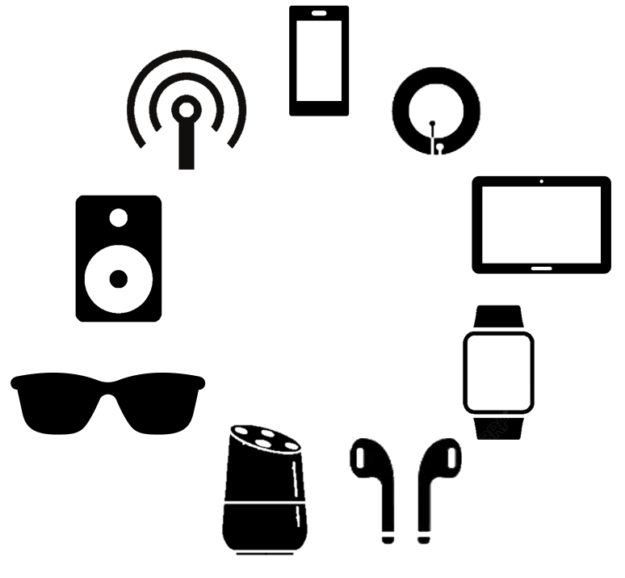


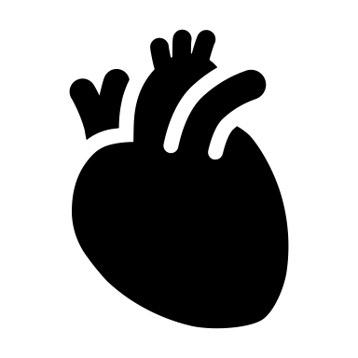


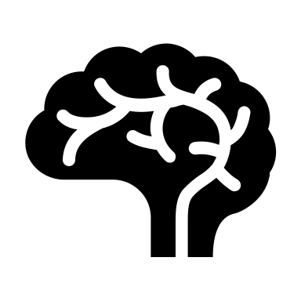
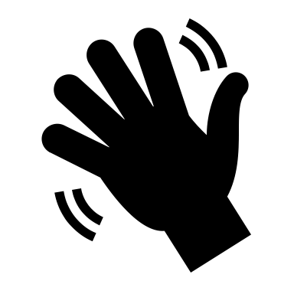

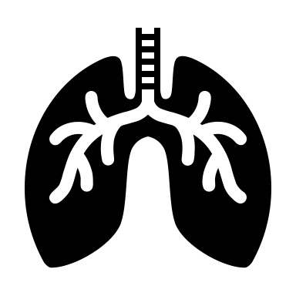
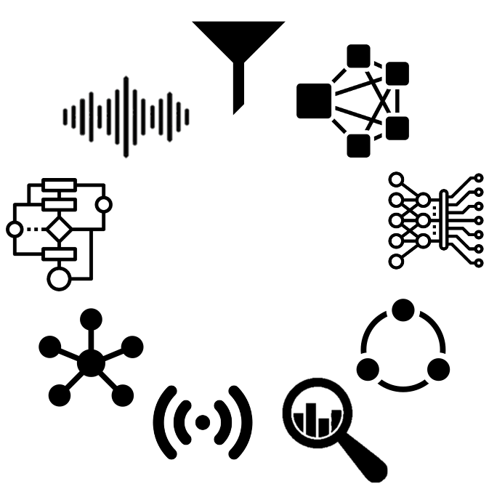
Principles
Applications
Behaviors
IoT
Physical behaviors
Techniques
Physiological behaviors
Notes:
To be more specific, this thesis targets designing new human behaviour-sensing principles based on IoT sensors. Also, since the IoT sensors are much more cost and power-efficient than traditional sensors, as a trade-off, the sensing accuracy shall be compromised. Therefore, proposing new data analytic algorithms to fit the sensory data is another objective. With these tools at hand, various human behaviour-sensing applications can be enabled, including both physical and physiological behaviours.
I narrow down the scope of this thesis into two specific applications. For the physical behaviours, I will focus on designing interaction gesture recognition systems, considering the prevalence of such tasks. For the physiological behaviours, I will focus on analysing pulmonary activities because pulmonary diseases are largely chronic and require long-term management, and this is where cost-efficient IoT devices can help.

Slide 2
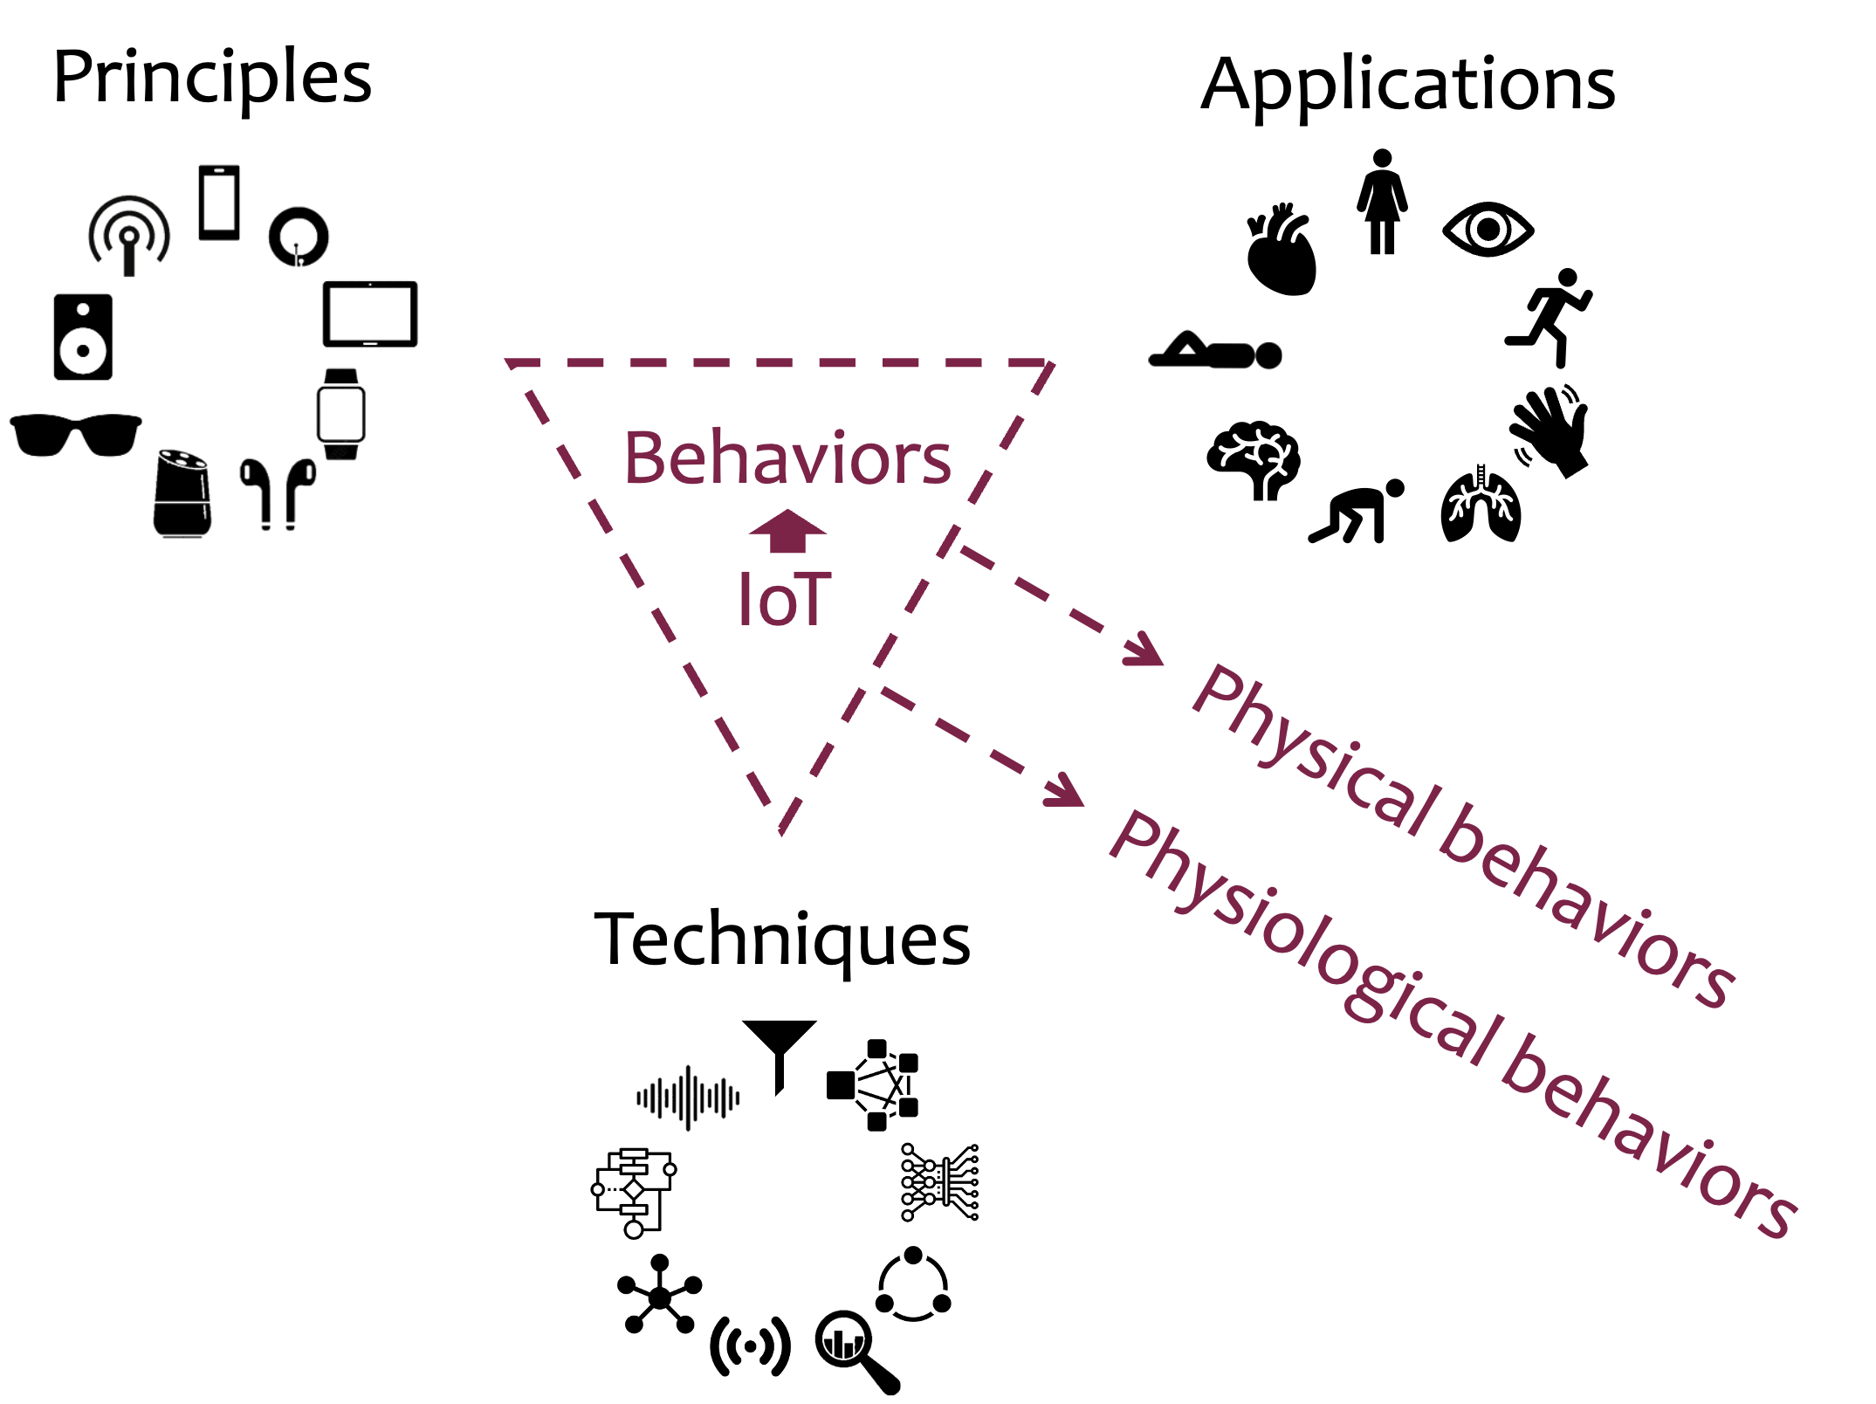

Slide 3
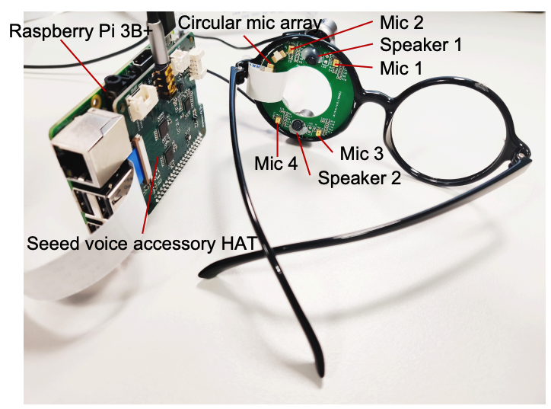

Facial Actions
Facial action sensing with ultrasounds on glasses

Slide 4


Slide 5


Slide 6
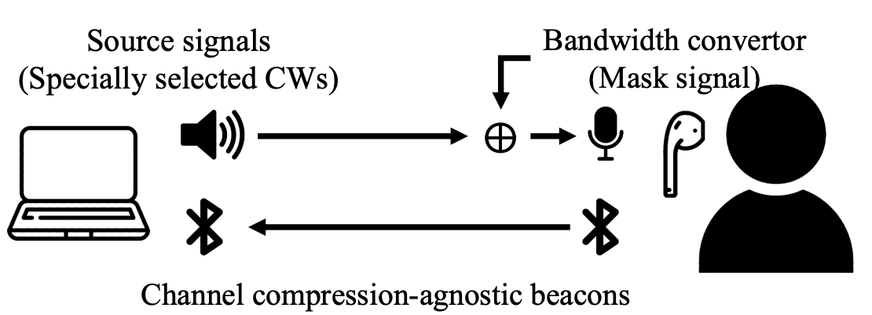
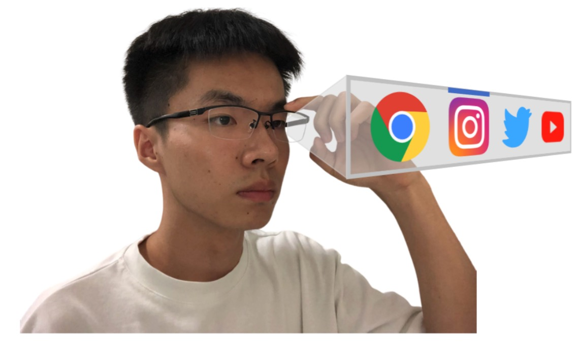

Slide 7
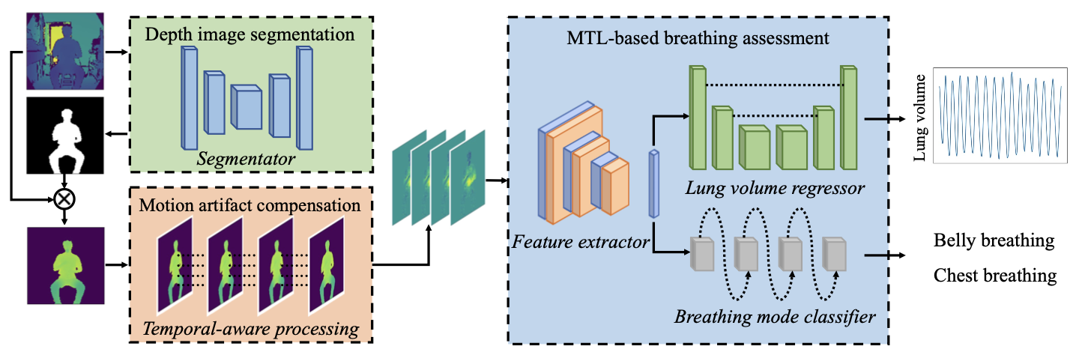
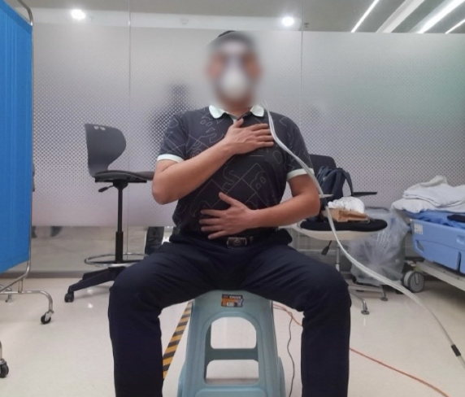
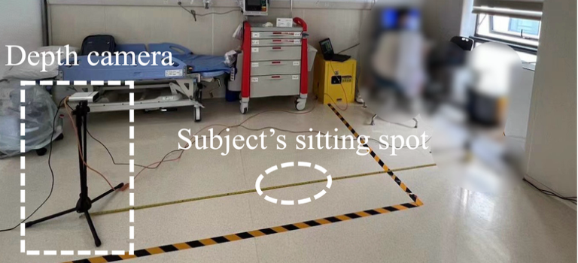
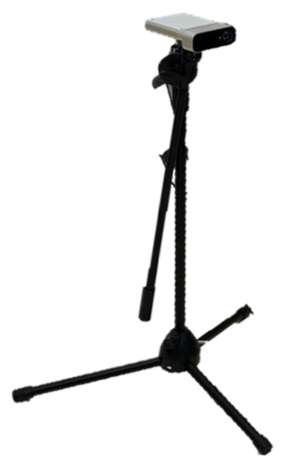

Slide 8
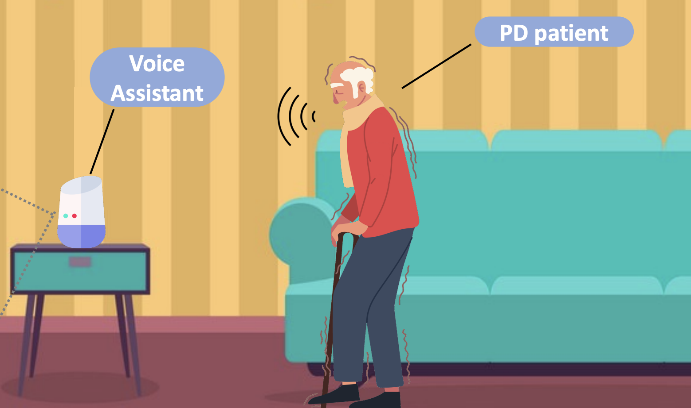

PD severity assessment using free speech recordings

Slide 9
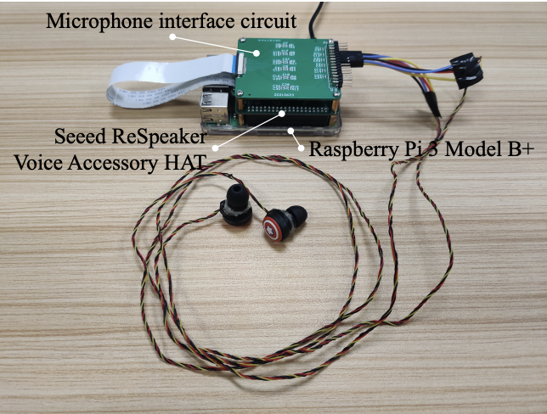
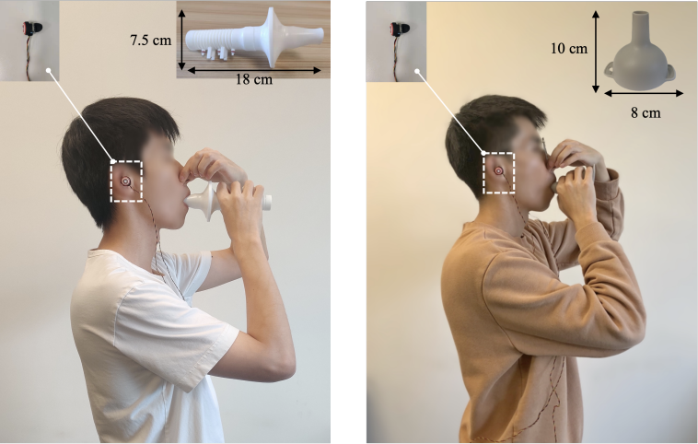
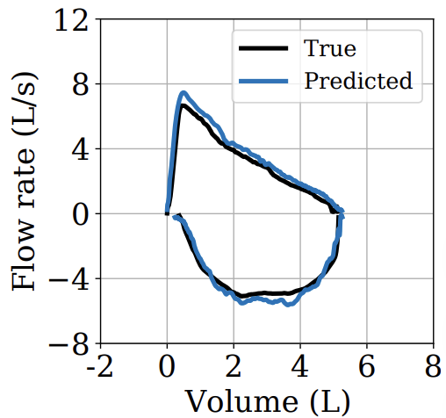

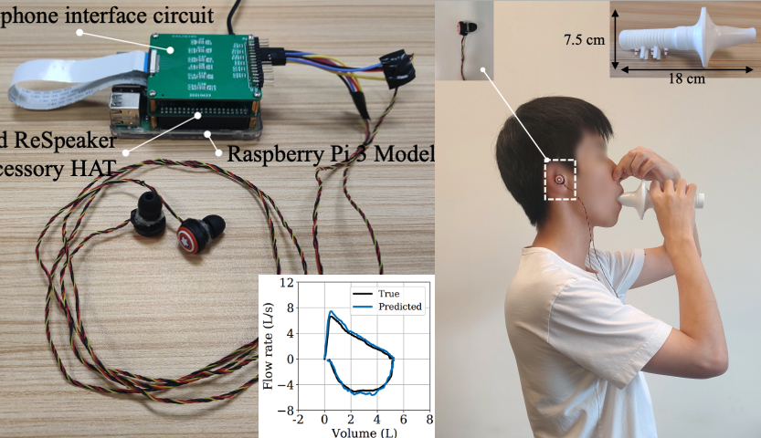
EarSpiro
Lung function assessment using expiration sounds

Slide 10
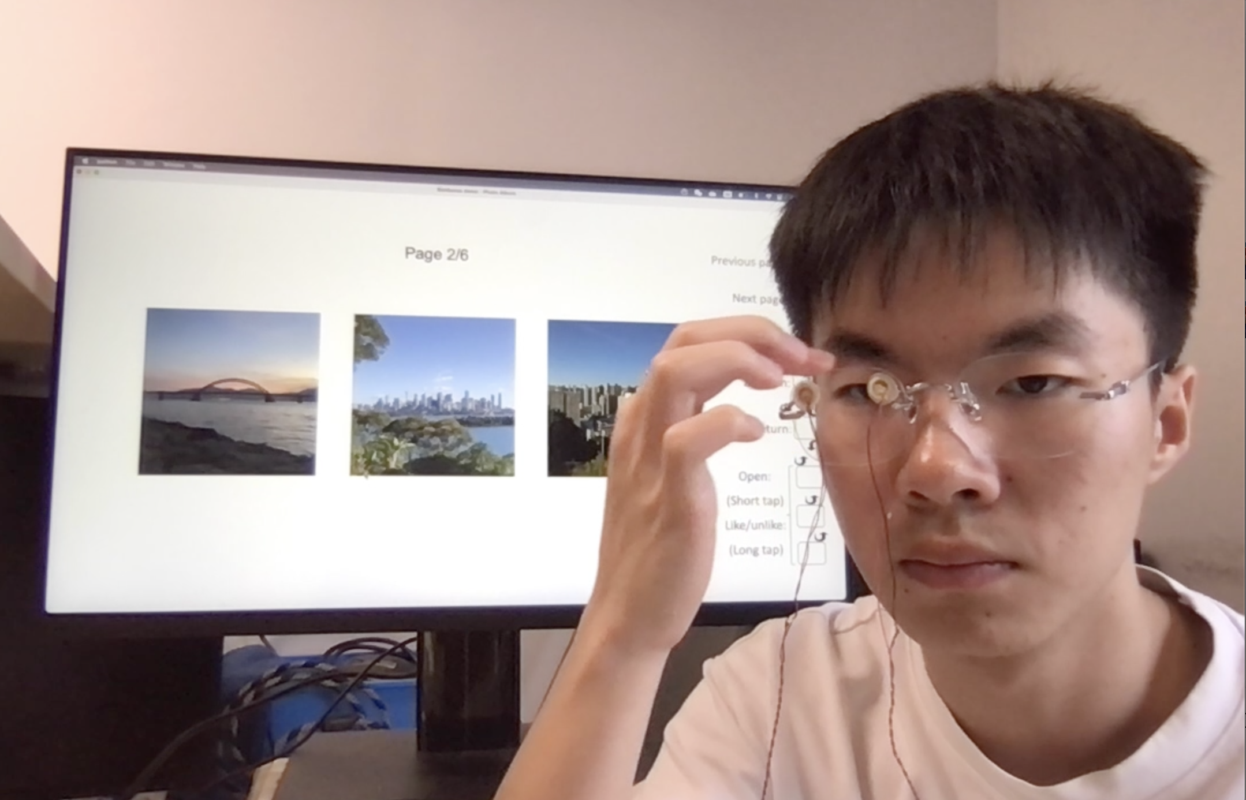


On-glass touch gesture recognition with PZT sensors

Slide 11
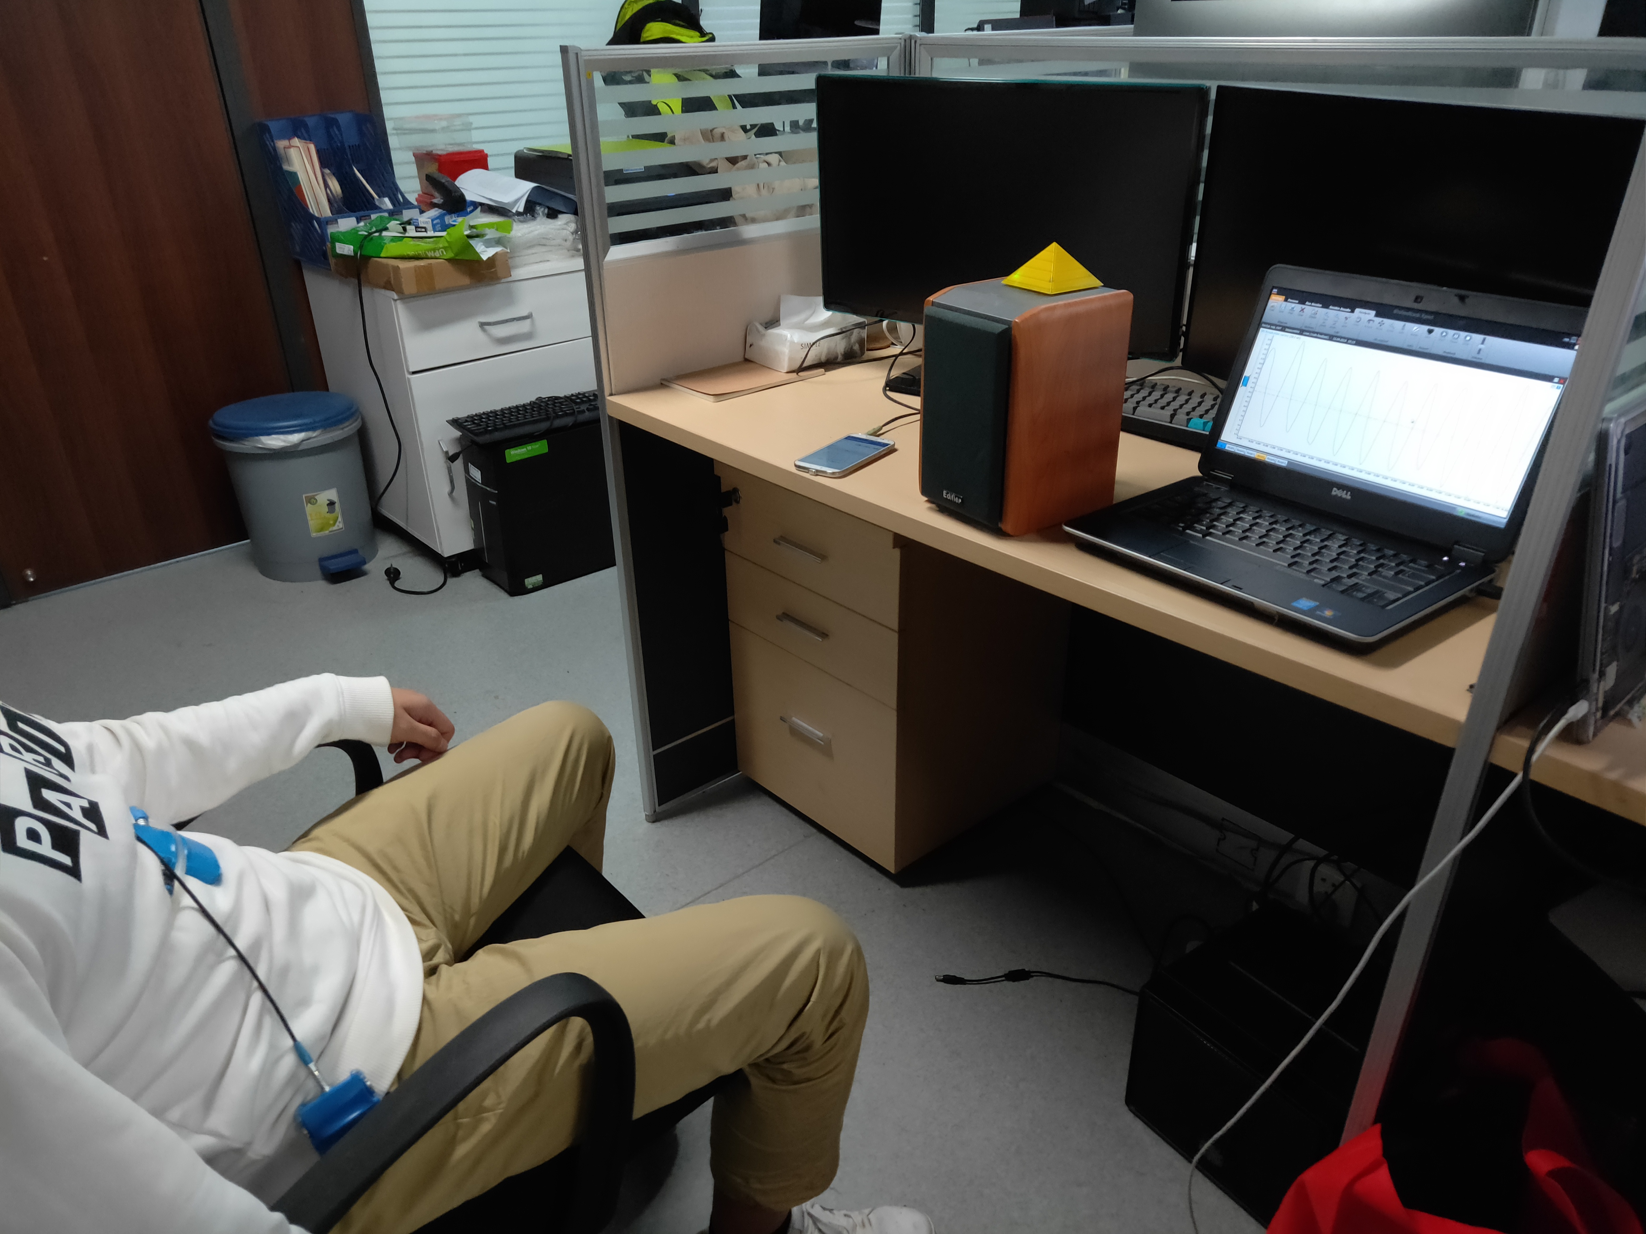


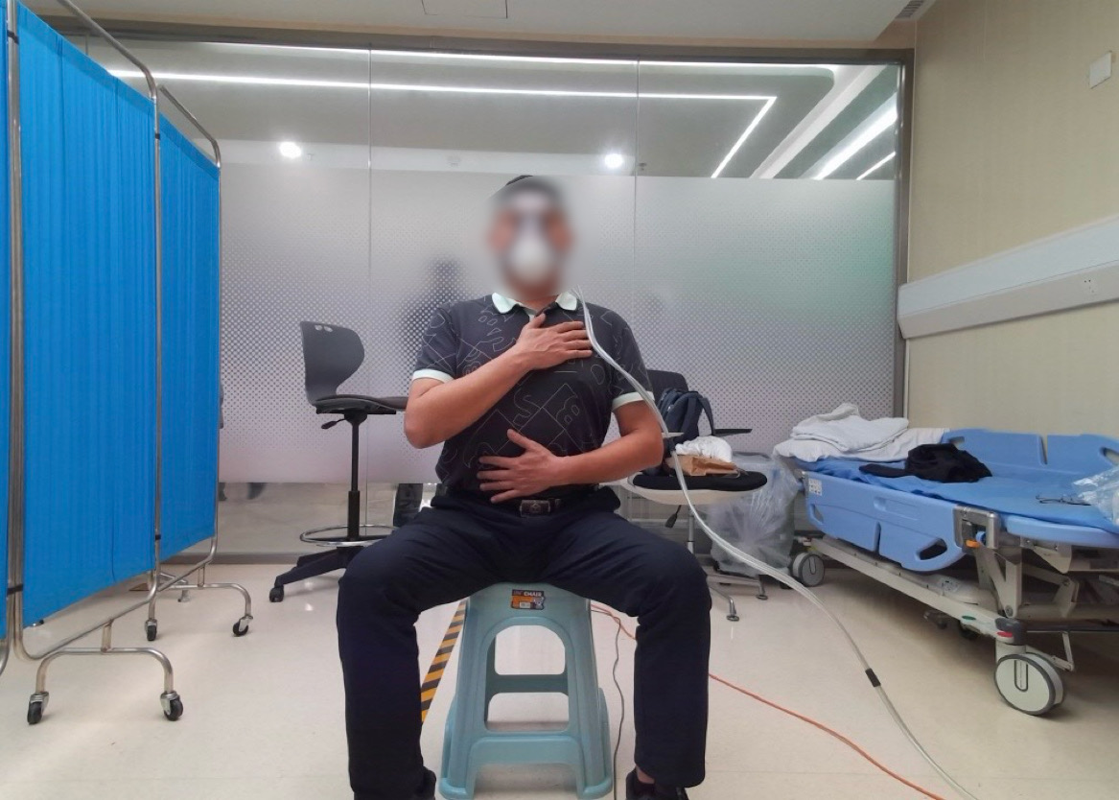

Breathing Detection

Slide 12

DeepBreath

Slide 13
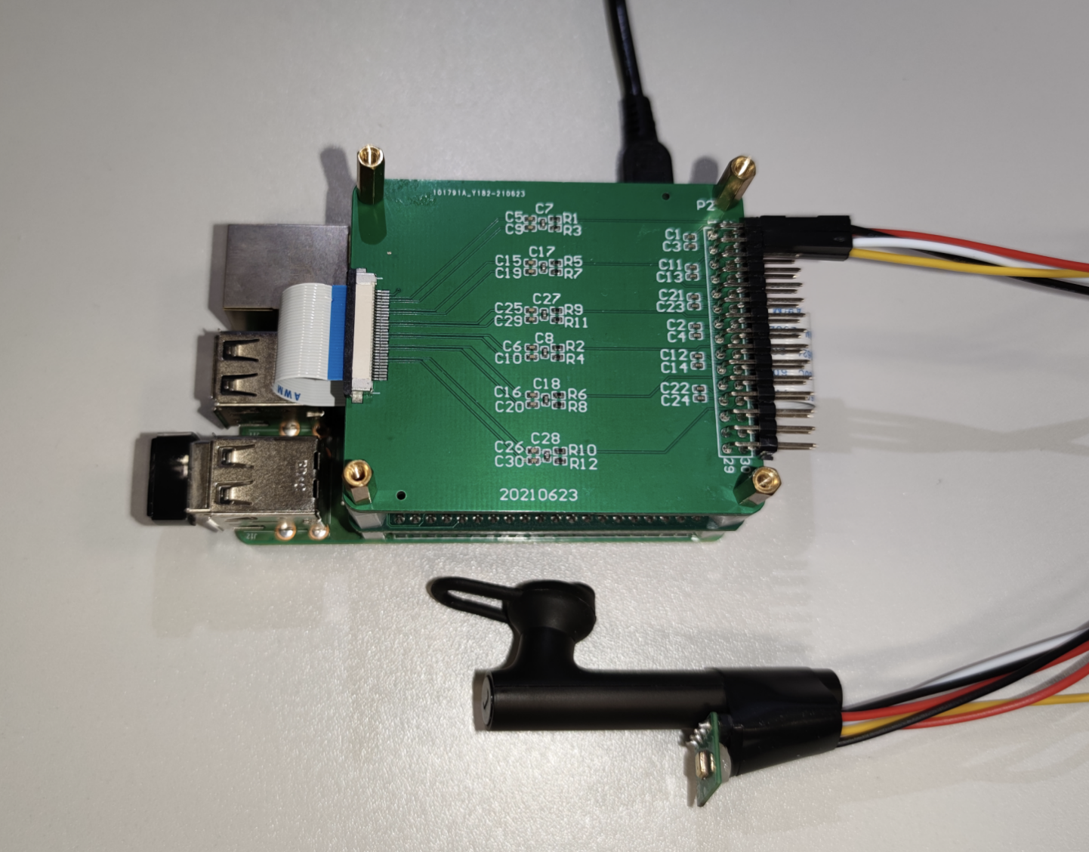


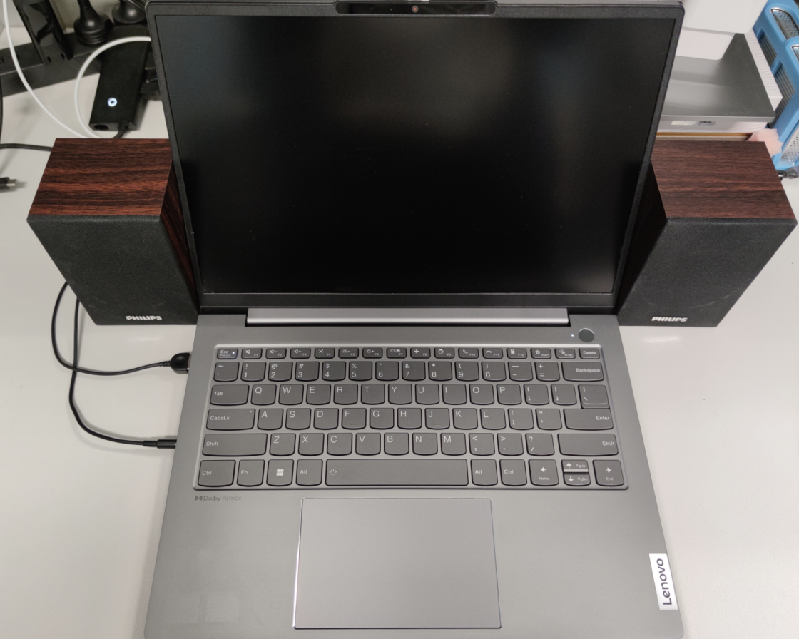
BLEAR
Practical earphone tracking under BLE

